Slide 1
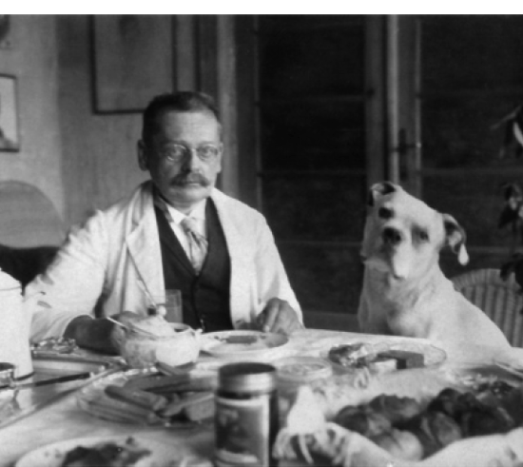
Zermelo a new proof of the Possibility of well-ordering (1908)

Slide 2
Definition of “ordered”
Partially ordered – A poset consists of a set together with a binary relation, indicating that one of the elements preceeds the other. “Partial” is used to indicate that not every pair of elements is comparable.
Totally ordered – a total order or a totally ordered set is a set plus a relation on the set that satisfies the conditions for a partial order plus an additional condition know as the comparability condition.

Slide 3
Historical Background
“The concept of well-ordered set reveals itself as fundamental for the theory of manifolds. That it is always possible to arrange any well-defined set in the form of a well-ordered set is, it seems to me, a very basic law of thought, rich in consequences, and particularly remarkable in virtue of its general validity. I will return to this in a later memoir.”
Cantor 1883, Über unendlichliche, lineare Punktmannifgaltigkeiten”, Mathemathische Annalen

Slide 4
Zermelo’s first proof of well ordering (1904)
This proof is built arround the construction of a set Lγ, which is the union of γsets generated by the choice function.

Slide 5
Objections
Zermelos' principle fails to specify a 'law' or 'rule' by which the choices are affected. Borel (1905)
Since the choice principle cannot be proven syllogistically it must be rejected. Peano (1906)
Zermelo's general operation with sets employs procedures which are reminiscent of those used crucially in the generation of the Burali-Forti antinomy, e.g., in showing that if the set Lγ ≠ M, then it can be extended. (What if Lγ is already the collection W?)

Slide 6
1904 Proof
Suppose M is the set given, and suppose 𝔘M is the set of its subsets (‘Untermengen’).
The basic procedure in the 1904 proof was to single out certain subsets of M and to show that these can in effect be ‘chained’ together, starting from modest beginnings
using the choice function γ
Thus we have {m1}, where
m1 = γ(M),
m2 = γ(M − {m1}), and so on…
In this way, the proof shows that one can ‘build up’ to the whole of M itself.

Slide 7
Second Proof (1908)
Reverse inclusion
Transfinite Recursion

Slide 8
Second Proof (1908)
The basic idea is to start from M itself
b) Start ‘cutting down’ by the element ‘chosen’ by the choice principle instead of building up.

Slide 9
Second Proof (1908)
c) If M is a legitimate set, then so is 𝔘M, and there is not the same danger of extending into inconsistent sets.
Crucially important to point out that the well-ordering in this case is carried out in accordance with the relation ⊂.

Slide 10
Second Proof (1908)
Keep in mind that the well-ordering relation is ⊂.
Conditions for a well-ordering are satisfied because:
Irreflexive
Assymetrical
Transitive
Connected (comparable)

Slide 11
The transfinite recursion defines an infinite sequence (theta chains).
There is one theta chain M, the intersection of all the other theta chains.
M is well-ordered by M.

