Slide 1
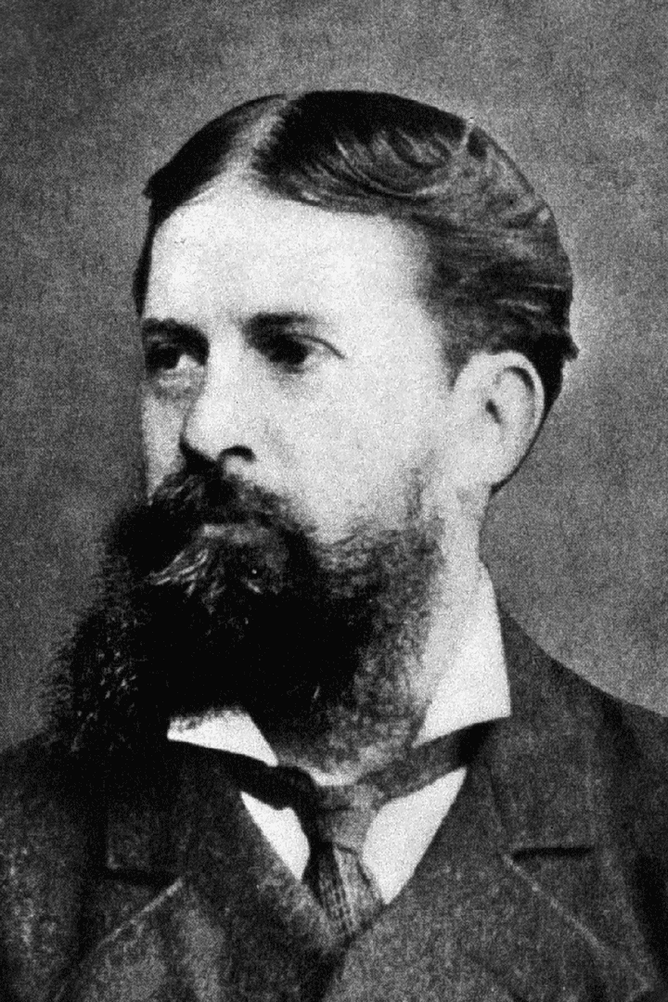
Algebraic logic in the 19th century
Charles Sanders Peirce
(1839 - 1914)

Slide 2
George Boole (1847, 1854): algebra of unary predicates
Attempts to construct an algebra of binary predicates:
A. De Morgan, 1860’s
Relational product: yRSx ⇔ ∃z(yRz ∧ zSx)
Read: y is an R of an S of x.
Two „sums”:
y(R+’S) x ⇔ ∀z(zSx→yRz)
I. e., y is an R of every S’s of x.
y(R+”S)x ⇔ ∀z(yRz→zSx)
y is an R only of x’s S-s.
Converse: xR˘y ⇔ yRx
Connections:
(RS)˘ = S˘R˘

Slide 3
Frege: Interpreted language + fixed universe
Algebraic logicians: algebraic expressions with changing interpretation (→ model theory).
Jourdain 1914: Algebraic logicians concentrate to the Leibnitian idea of calculus ratiocinator, follower of the logistic tendency to the lingua characteristica.

Slide 4
Peirce
Relative terms: n-ary predicates in general (n≥2)
They are common names denoting ordered n-tuples.
„Dual relative terms”: binary predicates.
Operations for binary predicates:
Inner/non-relative multiplication and addition: Boolean conjunction resp. disjunction.
L+B denotes the ordered pairs where the first member is a lover or a benefactor of the second.
Converse on the usual way.
Relative product: the usual way again.
Relative sum: L†B : „a lover of everything but benefactors”

Slide 5
Quantification (1883)
Universe: {a₁, a₂, … a_{n}, …}
Value of a term F for an object a_{i}:
[F]_{i}=1 if a_{i} has the property F, 0 in the other case.
[L]_{ij}=1 if a_{i} loves a_{j}, 0 in the other case.
„There are some Fs” is true iff $\sum_{i}{\left[F\right]i}$ >0
„Somebody is a lover of somebody” is true iff $\sum_{i}{\sum_{j}{\left[F\right]ij}}>0$
„Everything is F” is true iff $\prod_{i}{\left[F\right]i}$>0
(Σ, Π: usual arithmetical meaning)
„Any proposition whatever is equivalent to saying that some complexus of aggregates [sums] and products of numerical coefficients is greater then zero.”
Remarks:
Negations can be brought to such a form by the de Morgan-rules.
We can leave off „>0” and the square brackets.

Slide 6
Operations and quantification:
${SJ}_{ik}= \sum_{j}{S_{ij}{,B}_{jk}}$ (concatenation denotes relative, comma Boolean product)
${(S\text{†}J)}_{ik}=$ $\prod_{j}{(S_{ij}+B_{jk}}$)
Most important result: Every formula can be written in prenex form (sequence of quantifiers + Boolean polinom).
Second-order logic (1885)
„Second-Intentional Logic”
Definition of identity:
$I_{ij}$ = $\prod_{X}{{(X}_{i}}$∧$X_{j})$ ∨ (¬$X_{i}$∧¬$X_{j})$

Slide 7
Existential graphs
Propositional logic: alpha-graphs
P, Q, R: elementary propositions
This is a sheet equivalent with claiming the proposition P; the graph of the proposition P is the letter itself.
This is „P ∧ Q”; the graph consists of the two letters, and the sheet has the meaning that we claim this conjunction.
P
P Q

Slide 8
¬P:
The closed line is a cut or sep, the sign of negation.
The area separated by the cut is a context (marked with red).
The part of the sheet outside of every cut is a (distinguished) context, too: we are claiming the proposition represented by this context.
P

Slide 9
Let us interpret this sheet:
In the innermost, blue context we have Q.
Seen from the next, red context, Q is negated, and we have P. So in the red context we have „P∧¬Q”.
In the outermost, distinguished context we have negated the content of the red context, therefore the sheet claims „¬(P ∧ ¬Q)”.
The figure consisting of two letters and two cuts is the graph of „P→Q”.
Q
P

Slide 10
The outermost context and the contexts delimited by an even number of cuts are positive contexts.
Contexts delimited from the outermost context by an odd number of cuts are negative contexts.

Slide 11
Beta-graphs: First-order logic
Letters stand for predicates now.
A continuous line (identity line) corresponds to an individual variable bounded by an existential quantifier.
The arity of a predicate is determined by the number of identity lines joined to it; the arguments are the variables.
Be A: artist, F: falsifier.
$$∃xA(x)∃xF(x)$$
A
F

Slide 12
A
F
$$∃x\left(A\left(x\right)∧F\left(x\right)\right)$$
$∃x(F\left(x\right)∧¬A(x)$)
A
F

Slide 13

A
F
$$∀x(F\left(x\right)→A\left(x\right))$$
$∃x(A(x)∃yF(y)x$y)
Alpha-graphs: special case of beta-graphs, with 0-place predicates.
A
F

Slide 14
Identity lines may be branching with many endpoints: many predicates about the same individual.
An artist, who is not a falsifier, likes a dog.
If a farmer owns a donkey, he beats it.
F
L
D
A
Owns
Farmer
Donkey
Beats

Slide 15
Calculus
P ⇒ K if it is possible to transform by the rules the sheet representing P to a sheet representing K.
Axiom: the empty graph (tautology).
Rules:
(Erasure) Any graph G may be erased in a positive context.
(Insertion) Any graph G may be inserted in a negative context.
(Iteration) If an instance of a graph G occurs in a context c, another instance of G may be inserted in c or in any context nested in c.
(Deiteration) An occurrence of a graph G that could have been derived by iteration may be erased.
(Double cut) Two cuts may be drawn around or can be removed from every graph, provided that no graph occurs between the cuts in question.

Slide 16

Derivation of „$P→P$”:
Axiom
1. Double cut
2. Insertion
3. Iteration
P
P
P

