Slide 1
Plato
Mathematics, dialectics, method
Homologemata that resemble logical principles
Semantic problems
Why things „deserve their names”?
Relational propositions

Slide 2
Republic 510b (line-metaphor):
Oppositon: end-point vs. origin
To the end-point: from assumptions (hypotheses)
How can we move to the „origin”? How can we get rid of the assumptions?

Slide 3
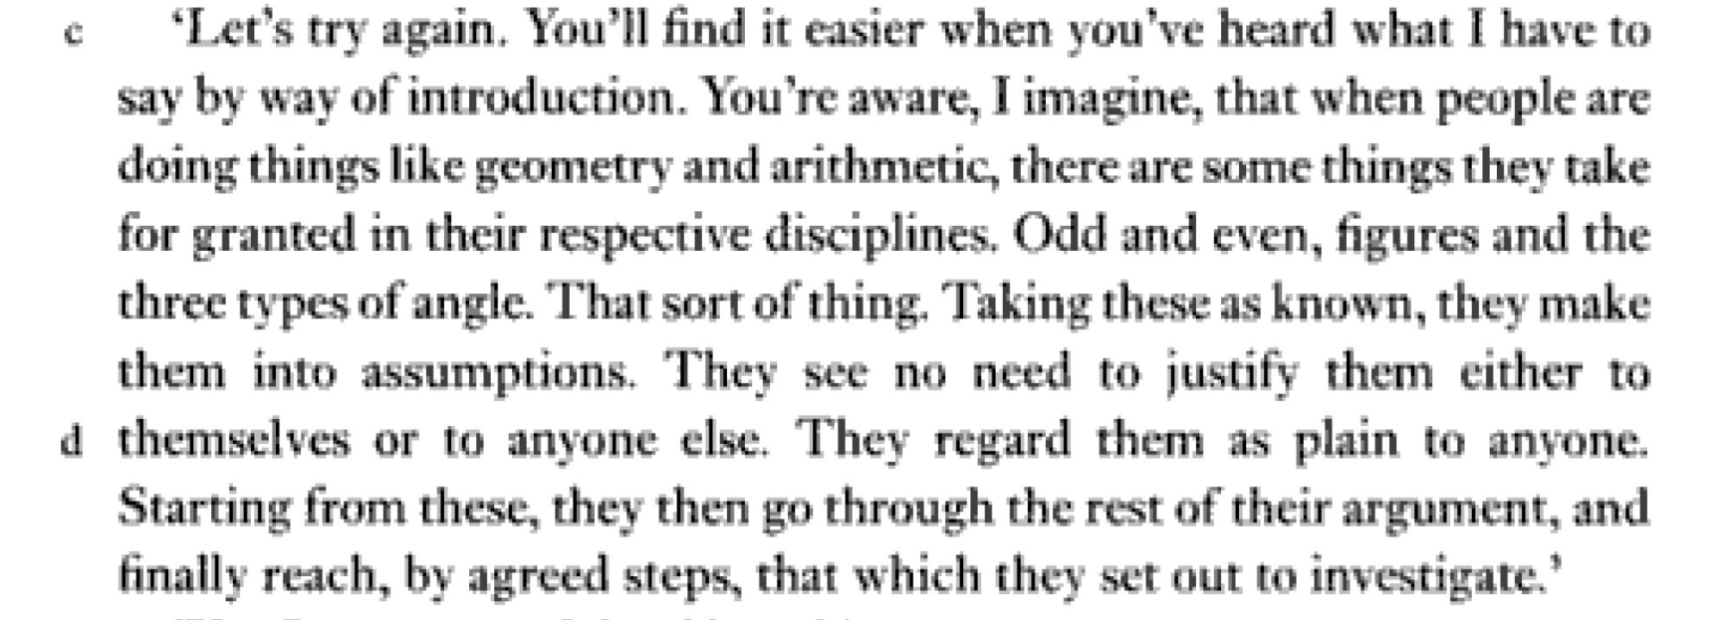
Mathematical objects (vs. ideas)
Mathematics: deduction from hypotheses
The arkhai of the mathematician are just hypotheses but the mathematician takes them as final truths.
A problem: what does the mathematician accept here? Mathematical objects (their existence) or fűdefinitions, axioms concerning them?

Slide 4
511bff.:
The dialectician treats the assumptions just as (refutable) assumptions
Infallibilist, dogmatic vs. fallibilist, sceptic viewpoint
Spatial metaphor: downwards-upwards
Can we prove „upwards”?
Could we prove axioms of a math. theory indirectly?
Is it a reasonable goal for the sceptic to became a dogmatic?

Slide 5
Parmenides, 136a:
The opposite hypothesis: the not-being of the many.
Two tentative explanations to the „way upwards”:
If one of the two investigations runs to some contradiction, then the other remains as valid.
If something follows from both the hypothesis and its negation, then it should be true.
(Constructive dilemma, {B → A; ¬B → A} ⇒ A})

Slide 6
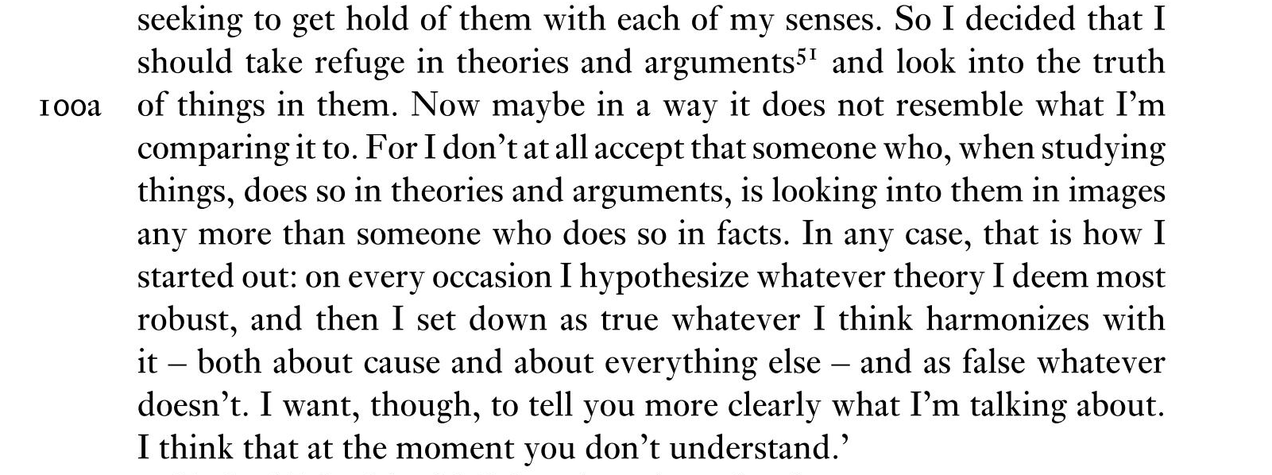
Phaedo 99e f. about the „second sailing”:
„[the] theory (or proposition, logos) I take most robust”: the existence of ideas.
Harmonize: not just consepuence, but other, coherent hypotheses.
Doesn’t harmonize: maybe contradict.

Slide 7
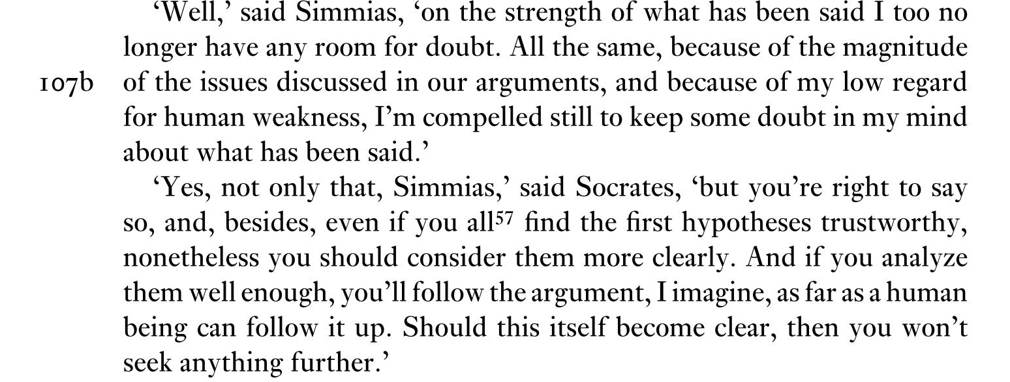
Closing part of the argument about the immortality of the soul:
Methodological scepticism
with the slight hope of reaching „the origin”

Slide 8
Principle of Contradiction:
Republic 436:
Is it the PC as the fundament of the method?
Continuation:

Slide 9
The conditions under which a thing cannot have opposite properties:
„in the same time” (hama), „in the same respect” (kata tauta), „in the same relation” (pros tauta) occur in (by and far) the same form
in the Sophist (230 b)
and in Aristotle, Metaphysica Γ, where he says that
it is not possible that the same thing does and does not have the very same property under these conditions.
The formulation is obviously a standard one. But:
Plato speaks always about opposites
and he defines (predicate) negation based on opposites in the Sophist.
If the Forms A and B are opposites, then A cannot be B and vice versa.
It has consequences for the visible world.
It is independent of any condition.
See: Phaedo, next time.

